Slide 1


Etienne Chénais
26.02.2024

Slide 2

Outline
Executive Summary
Introduction
Methodology
Results
Conclusion
Appendix

Slide 3
Executive Summary
Data collection and Wrangling
Exploratory Data Analysis
Model Definition
Data collection from two different sources:
SpaceX API
Webscraping
Handling of missing values and one-hot encoding of categorical variables
EDA performed visually
Analysis of SQL data
Creation of interactive media:
Folium maps
Dashboard with interactive graphics
Generation of 4 models:
Logistic Regression
Support Vector Machine
Decision Tree Classifier
K Means Model
Accuracy testing using testing data and confusion matrix
Methodology
Identification of relations between launch site, payload mass, orbit type, date and landing success outcome
Landing outcome increased with time
Launch sites are strategically placed near points of interest
Data gathered and cleaned successfully into a cohesive and coherent dataframe
Data exported as CSV document
All models had similar results:
Model Accuracy of 83%
Good sensitivity but lacking specificity
Outcomes

Slide 4
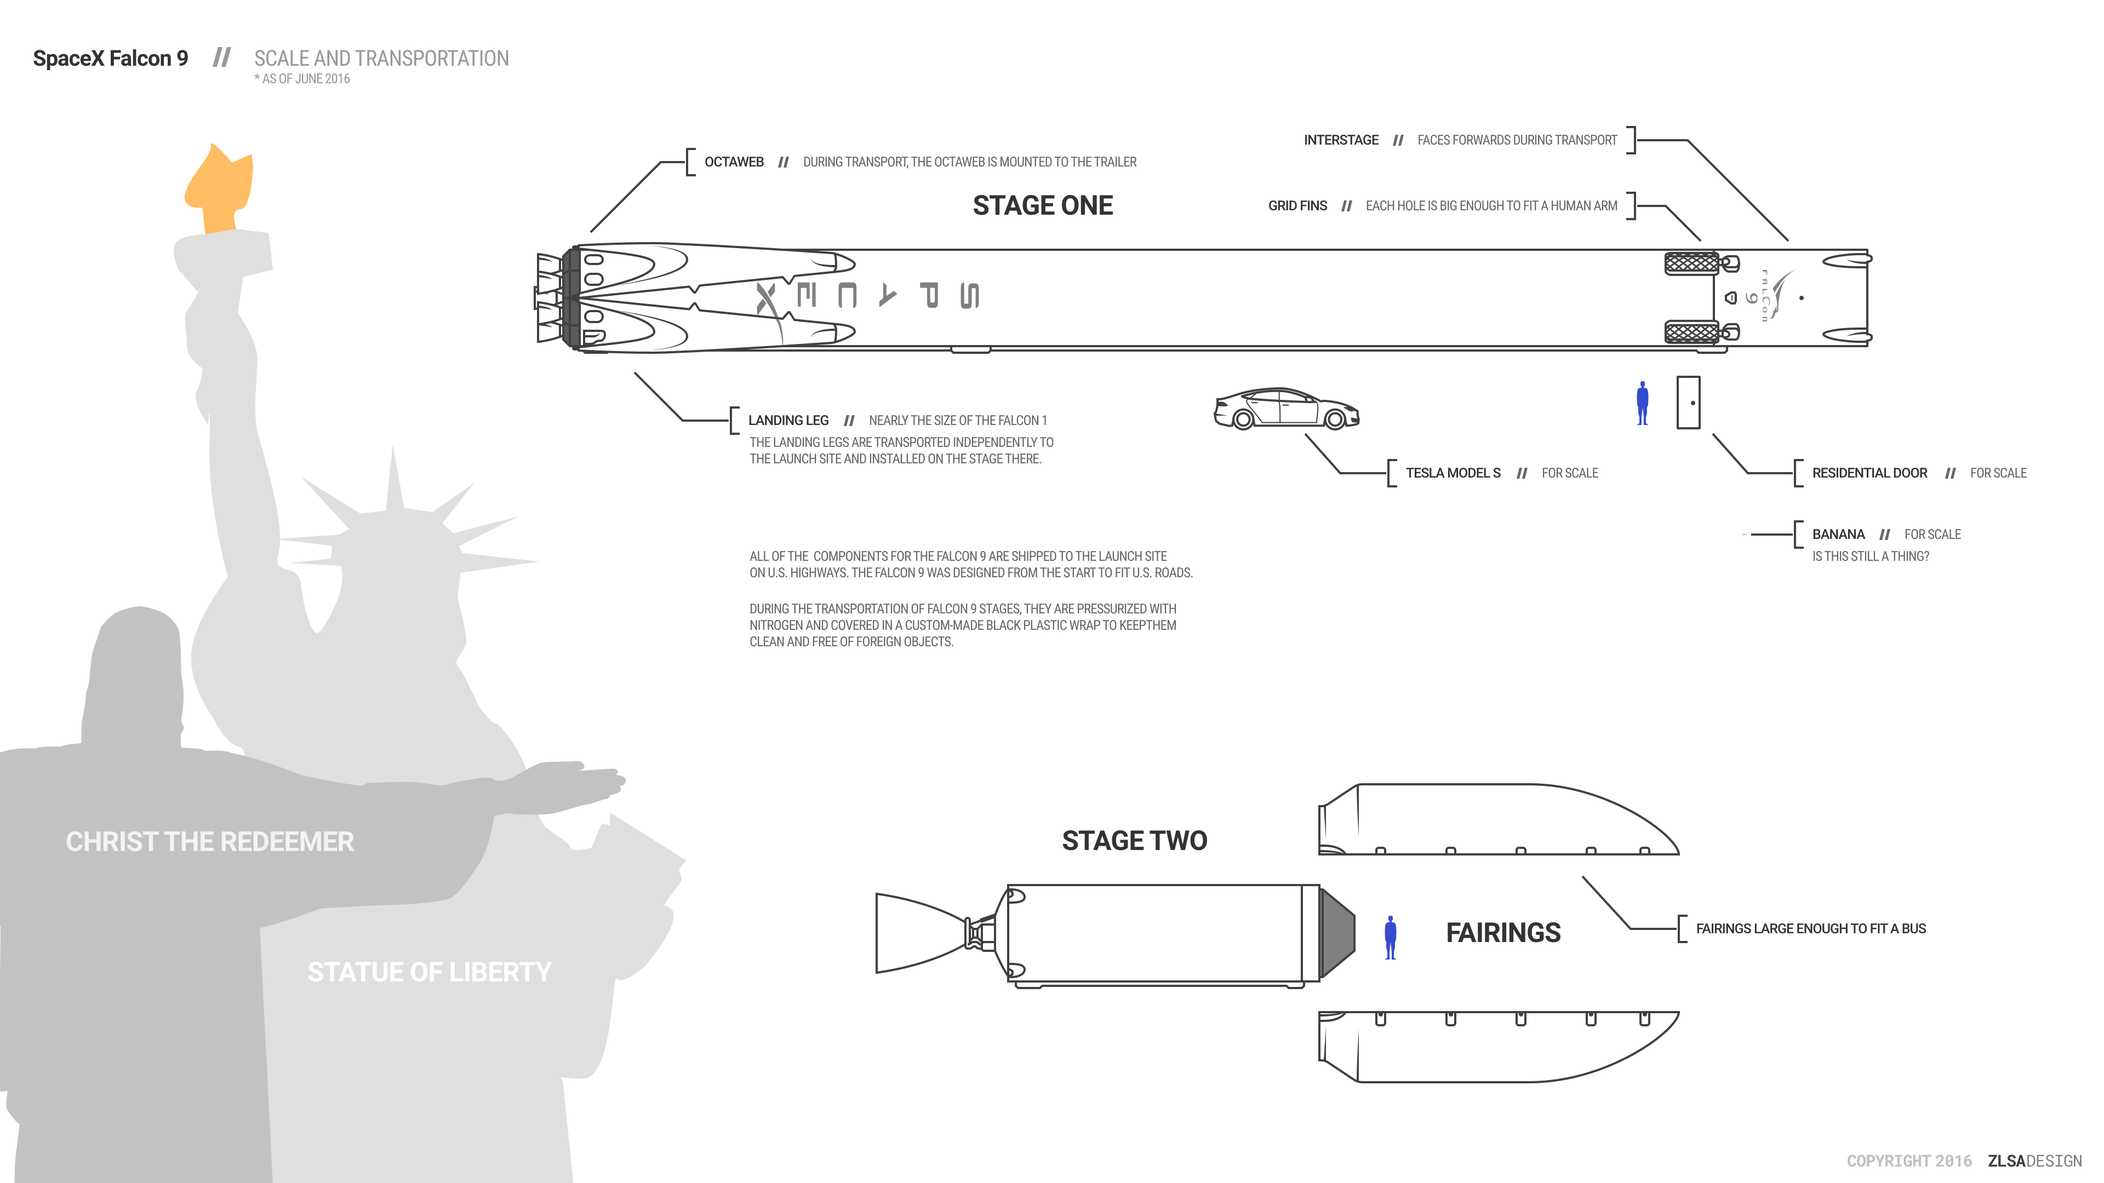
Introduction
1. Context
Rockets launch in three main stages:
First stage
Performs most work from launch to orbitation
Stage two
Helps bring the payload to orbit
Fairings
Contain the payload of the rocket
Image credit: zlsa.github.io/infographics
Space X has great success in today’s commercial space race
Falcon9 rocket has a reusable first stage
Drives launch prices down

Slide 5



Introduction
2. Project Objectives
Reusable First stage
Lower Launch Price
Determining whether the first stage will land or not upon launch will help determine launch costs
Possible outcomes
1st stage lands
1st stage crashes
1st stage sacrificed
1st stage doesn’t land
Rocket Launch
Retrieval success
Retrieval fail
Objectives:
Using data from SpaceX launches:
Determine important parameters to assess retrieval success or failure
Create predictive models to determine retrieval success based on launch conditions

Slide 6

Section 1

Slide 7
Methodology
Executive Summary
Data collection methodology:
Data collection using the SpaceX API
Data collection using webscraping
Perform data wrangling
Handling of missing values
Modification of categorical into numerical variables (one-hot encoding)
Perform exploratory data analysis (EDA) using visualization and SQL
Perform interactive visual analytics using Folium and Plotly Dash
Perform predictive analysis using classification models
Data splitting into training and testing sets
Grid Search on parameters
Model fitting
Accuracy calculation on testing data and confusion matrix generation

Slide 8
Data Collection
Primary data collection
Data collected from 2 sources:
Retrieval of supplementary data from annex databases if needed
SpaceX API
Using the past launches data base
Data cleaning and formatting
Webscraping
Using a table summarizing past launches on the SpaceX Wikipedia page
Saving the data into CSV file

Slide 9
Data Collection – SpaceX API
We used the SpaceX API to retrieve relevant data.
Data primarily retrieved from the past launches DB.
Data filtered, reformatted and completed with additional information
Data consolidated into one table and exported into CSV file
SpaceX API
launches/past
Data retrieval using Requests library
SpaceX API
rockets
Raw data in JSON File
Normalization into Pandas DataFrame
SpaceX API
launchpads
Raw data in Pandas DataFrame
Removal of Falcon 1 launches
Removal of unnecessary columns
SpaceX API
payload
Filtered data in Pandas DataFrame
Addition of booster, launch site and payload data
Consolidated data in one DataFrame
Export as CSV file
GitHub URL: https://github.com/tseesen/DataAnalysisProject/blob/main/Week1/jupyter-labs-spacex-data-collection-api.ipynb

Slide 10
Data Collection - Scraping
Raw Data
SpaceX wikipedia page
Data aggregation from Wikipedia page regarding SpaceX past launches
Data parsed using Python BeautifulSoup library
Data cleaning and export into CSV file
Import into Python using BeautifulSoup
Beautiful Soup Object
Data Parsing into tables
Table title
Column names
Raw data from columns
Aggregation into one coherent dataframe
Cleaned DataFrame with all data
Export as CSV file
GitHub URL: https://github.com/tseesen/DataAnalysisProject/blob/main/Week1/jupyter-labs-webscraping.ipynb

Slide 11
Data Wrangling
The following flowchart was applied for data wrangling:
Numerical data
Replace by mean values
Identification of numerical / categorical variables
Dealing with missing values
Data retrieval
Perform one-hot encoding on categorical data
Categorical data
Replace by most frequent occurrence or drop data
GitHub URL: https://github.com/tseesen/DataAnalysisProject/blob/main/Week1/labs-jupyter-spacex-Data%20wrangling.ipynb

Slide 12
EDA with Data Visualization
The effect of the following variables on landing success was assessed visually:
Launch site
Payload
Orbit type
Year
Flight number vs Launch site scatter plot
Landing success indicated as point color
Flight number vs Orbit type scatter plot
Landing success indicated as point color
1
4
Payload vs Launch site scatter plot
Landing success indicated as point color
Payload vs Orbit type scatter plot
Landing success indicated as point color
2
5
Average success rate per orbit type
Plotted as bar chart
Average success rate per year
Plotted as line chart
3
6
GitHub URL: https://github.com/tseesen/DataAnalysisProject/blob/main/Week2/jupyter-labs-eda-dataviz.ipynb.jupyterlite.ipynb

Slide 13
EDA with SQL
The following SQL requests were performed to output and assess data:
List of all unique launch sites
Sample of mission data for sites starting with CCA
Total payload mass for boosters launched by NASA
Average payload mass for booster F9 v1.1
First successful ground landing date
Booster versions for successful missions with a payload between 4000 and 6000 kg
Total number of successful and failed missions
List of all boosters having carried the maximal payload
Launch records with failed landing in 2015
Ranked landing outcomes for launches between 2010.06.04 and 2017.03.20
GitHub URL: https://github.com/tseesen/DataAnalysisProject/blob/main/Week2/jupyter-labs-eda-sql-coursera_sqllite.ipynb

Slide 14
Build an Interactive Map with Folium
Creation of a Folium map to assess spatial data analysis regarding SpaceX launch sites
The following objects were added on the map:
Markers, circle and labels indicating launch site positions
Marker clusters containing all launches for each site with a color discrimination for successful landing or not
Markers for assessing the proximity of a selected launch site to given landmarks: Line and marker
GitHub URL: https://nbviewer.org/github/tseesen/DataAnalysisProject/blob/main/Week3/lab_jupyter_launch_site_location.jupyterlite.ipynb?flush_cache=true

Slide 15
Build a Dashboard with Plotly Dash
Creation of a Python dashboard to vinualize data dynamically using the Dash and Plotly libraries
Dashboard structure
"All sites"
view
Pie chart showing the distribution of successful launches per site
Scatter plot showing launch success status depending on payload mass for all sites
Dashboard
View for a given launch site
Pie chart showing the percentage of successful launches for the site
Scatter plot showing launch success status depending on payload mass for the site of interest
GitHub URL: https://github.com/tseesen/DataAnalysisProject/blob/main/Week3/spacex_dash_app.py

Slide 16
Predictive Analysis (Classification)
Four ML models were built for predictive analysis:
Logistic Regression
Support Vector Machine
Decision Tree Classifier
K Means Model
For all models, the following pipeline was performed:
Model accuracy calculated with test dataset
Parameter definition and model instanciation with Grid Search
Data splitting into test and training subsets
Model fitting to training dataset
Test data prediction and generation of the confusion matrix
GitHub URL: https://github.com/tseesen/DataAnalysisProject/blob/main/Week4/SpaceX_Machine_Learning_Prediction_Part_5.jupyterlite.ipynb

Slide 17
Results
Exploratory data analysis results
Interactive analytics demo in screenshots
Predictive analysis results

Slide 18

Section 2

Slide 19
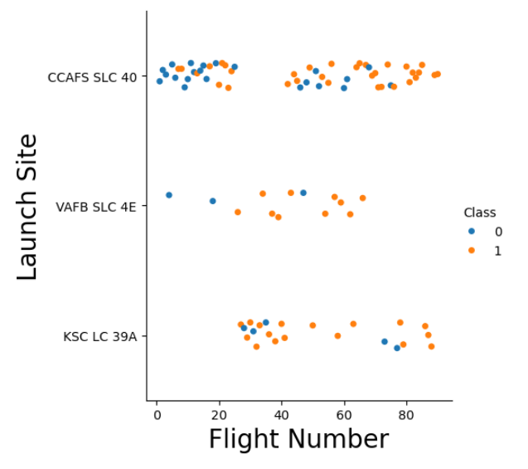
Flight Number vs. Launch Site
Launch site is plotted for each flight in the database
Class = 1: Landing success
Class = 0: Landing failure
Launch Site KSC LC 39A was used only for later flights
In general, later flights have a better success rate than earlier ones
Site CCAFS SLC 40 has more early fights, thus a lower success rate

Slide 20
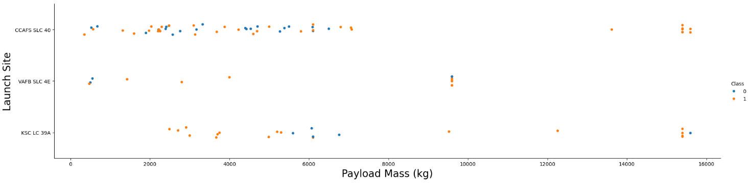
Payload vs. Launch Site
Payload mass plotted against launch site
Most payloads are small (< 10000kg)
Launch site VAFB-SLC has no rockets launched for heavy payload (> 10000kg)
Launch site KSC LC 93A has no launches with payload < 2000kg

Slide 21
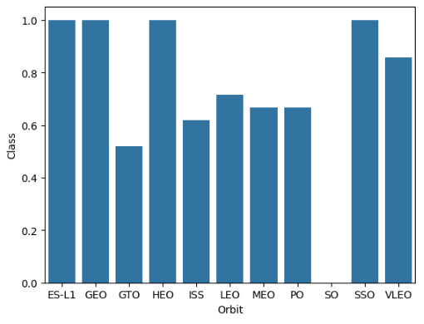
Success Rate vs. Orbit Type
Average success rate per orbit type
Orbit SO has an average success rate of 0. This is due to the fact that only one launch was performed for this orbit
In general, orbits ES-L1, GEO, HEO, SSO and VLEO seem to has a good retrieval rate compared to other orbits

Slide 22
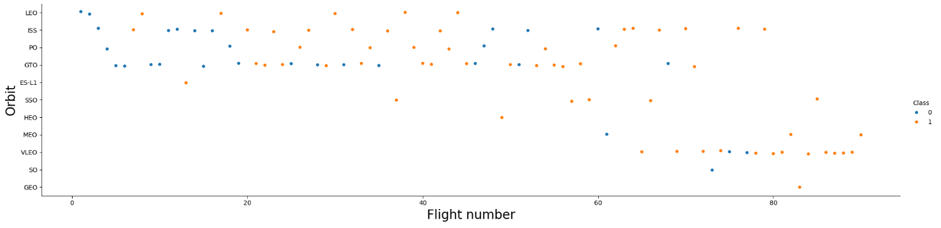
Flight Number vs. Orbit Type
Flight number plotted against orbit type
Flights were not sent constistently to all orbits
An improvement in success rate can be seen over time for orbit LEO
Other orbits do not show any clear relationship with the evolution of success rate (eg: ISS)

Slide 23
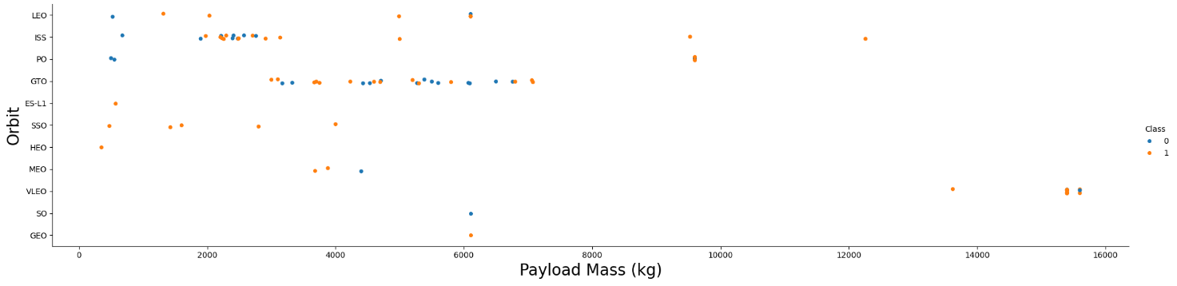
Payload vs. Orbit Type
Payload mass plotted against orbit type
Orbits PO and LEO have a higher successful landing rate for higher payloads
This trend is not confirmed for all orbits: For GTO, we cannot distinguish a clear impact of the payload mass on the success rate

Slide 24
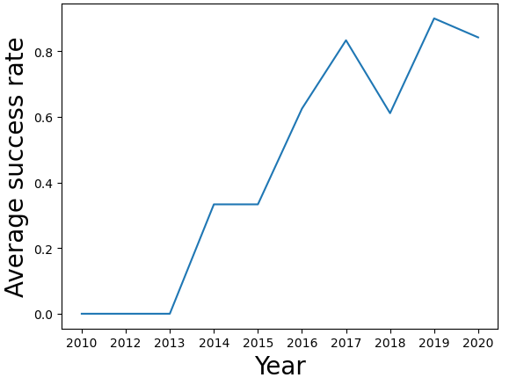
Launch Success Yearly Trend
Average yearly success rate
A clear increasing trend can be seen since 2013

Slide 25
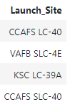
All Launch Site Names
After importation of the database as SQL:
Retrieval of unique launch site names using the following SQLite command:
Outcome:
Four unique launch sites were found:
%sql SELECT DISTINCT "Launch_Site" FROM SPACEXTABLE
CCAFS LC-40
VAFB SLC-4E
KSC LC-39A
CCAFS SLC-40

Slide 26
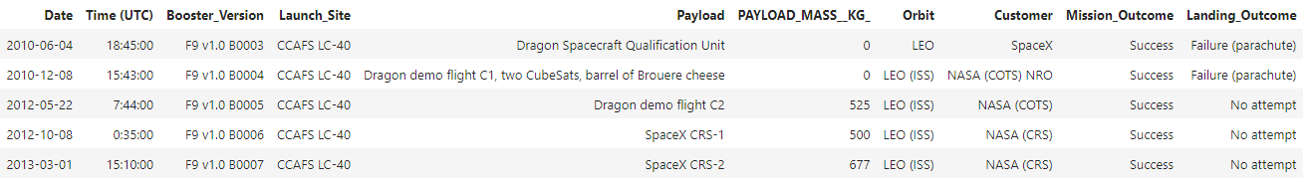
Launch Site Names Begin with 'CCA'
Retrieval of data for sites starting with CCA using the following SQLite command:
Outcome:
%sql SELECT * FROM SPACEXTABLE WHERE "Launch_Site" LIKE "CCA%“ LIMIT 5
Python Array of 5 elements
Each of the 5 elements represents one record (distinct launch)
Each launch element contains multiple elements (informations), including:
Booster version
Launch site
Mission and landing outcome
…

Slide 27
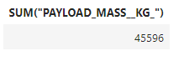
Total Payload Mass
Retrieval of the total payload mass carried by boosters launched by NASA:
Outcome:
The total payload mass for boosters launched by NASA is 45596 kg
%sql SELECT SUM("PAYLOAD_MASS__KG_") FROM SPACEXTABLE WHERE CUSTOMER LIKE "NASA (CRS)“

Slide 28
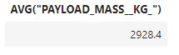
Average Payload Mass by F9 v1.1
Retrieval of the average payload mass for booster F9 v1.1 using the following SQLite command:
Outcome:
The average payload mass for booster F9v1.1 is 2928.4 kg
%sql SELECT AVG("PAYLOAD_MASS__KG_") FROM SPACEXTABLE WHERE "Booster_Version" = "F9 v1.1“

Slide 29
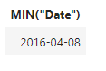
First Successful Ground Landing Date
Retrieval of the first successful landing date:
Outcome:
The first successful landing was accomplished on the April 8th 2016
%sql SELECT MIN("Date") FROM SPACEXTABLE WHERE LANDING_OUTCOME = "Success (drone ship)“

Slide 30
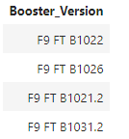
Successful Drone Ship Landing with Payload between 4000 and 6000
SQL Command:
Outcome:
Four different booster types were used for a payload between 4000 and 6000kg with a successful landing:
%sql SELECT Booster_Version FROM SPACEXTABLE WHERE ("PAYLOAD_MASS__KG_" BETWEEN 4000 AND 6000) AND ("Landing_Outcome" = "Success (drone ship)")
F9 FT B1022
F9 FT B1026
F9 FT B1021.2
F9 FT B1031.2

Slide 31
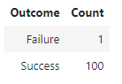
Total Number of Successful and Failure Mission Outcomes
SQL Command:
Outcome:
Count all "Landing Outcome" items in the database where the outcome was a success
%sql SELECT 'Success' AS Outcome, COUNT("Landing_Outcome") AS "Count" FROM SPACEXTABLE WHERE "Mission_Outcome" LIKE "%Success%" \
UNION SELECT 'Failure' AS Outcome, COUNT("Landing_Outcome") AS "Count" FROM SPACEXTABLE WHERE "Mission_Outcome" LIKE "Failure%"
Count all "Landing Outcome" items in the database where the outcome was a failure
Return the union of both counts hereabove aggregated into one table
Only one launch had a mission outcome classified as failure
100 Launches were classified as mission success

Slide 32
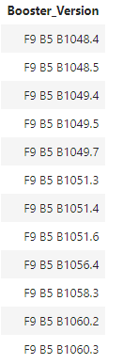
Boosters Having Carried the Maximum Payload
SQL Command:
Outcome:
%sql SELECT DISTINCT BOOSTER_VERSION FROM SPACEXTBL WHERE PAYLOAD_MASS__KG_ = (SELECT MAX(PAYLOAD_MASS__KG_) FROM SPACEXTBL) ORDER BY BOOSTER_VERSION
List of all distinct booster versions which carried the maximal payload mass observed in the database at least once
There is a large variety of boosters which carried the maximal payload mass

Slide 33
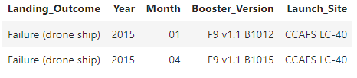
2015 Launch Records with Failed Landing Outcome
SQL Command:
Outcome:
%sql select "Landing_Outcome", substr(Date,1,4) AS ‘Year’, substr(Date,6,2) AS ‘Month’, "Booster_Version", "Launch_Site" from SPACEXTABLE where "Landing_Outcome" = "Failure (drone ship)" and substr(Date,1,4)="2015"
Record of all launches performed in 2015 having had a failed landing outcome, and their booster version and launch site
Two launches had a failed landing in 2015: one in January, one in April
Both had different booster versions but were launched from the same site: CCAFS LC-40

Slide 34
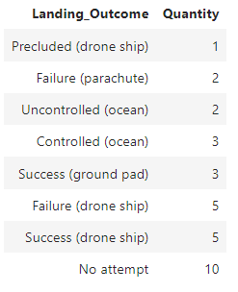
Rank Landing Outcomes Between 2010-06-04 and 2017-03-20
SQL Command:
Outcome:
%sql SELECT LANDING_OUTCOME, COUNT(LANDING_OUTCOME) AS 'Quantity' FROM SPACEXTBL WHERE DATE BETWEEN '2010-06-04' AND '2017-03-20' GROUP BY LANDING_OUTCOME ORDER BY "Quantity"
List of all landing outcomes between June 4. 2010 and March 20. 2017, ranked by number of respective outcomes
The most reoccuring outcome during this time frame is no attempt at landing the module

Slide 35

Section 3

Slide 36
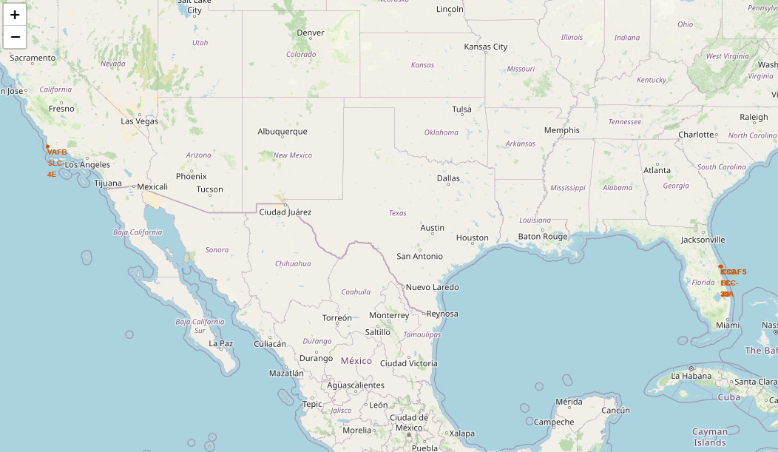
Global map of SpaceX launch sites
The map shows the locations for all four launch sites:
CCAFS LC-40
CCAFS SLC-40
KSC LC-39A
VAFB SLC-4E
Three launch sites are very close to each other
All launch sites are located near the coast and far south in the United States

Slide 37
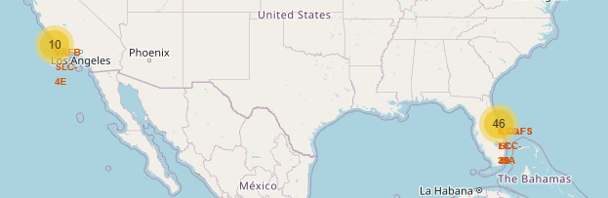
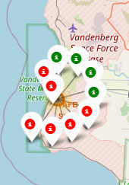
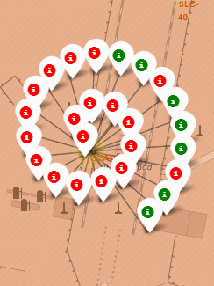
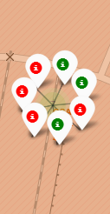
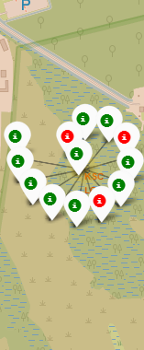
Launches per site
Maps showing all missions per launch site
Green indicates successful landing
Red indicates no successful landing
Number of launches per site cluster
Main observations:
Site KSC LC-39A seems to have a better launch success than other sites, however no clear tendency is observed
More launches were performed from the east coast than the west coast
Launches for site VAFB SLC-4E
Launches for site CCAFS LC-40
Launches for site CCAFS SLC-40
Launches for site KSC LC-39A

Slide 38
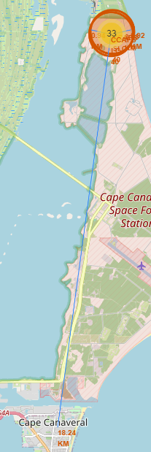
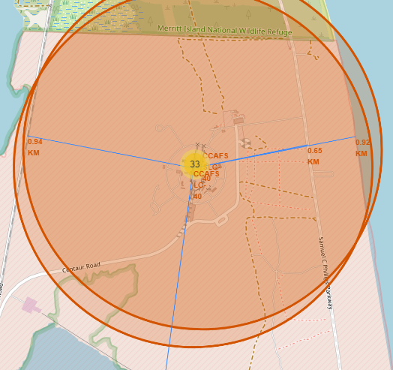
Proximity of site CCAFS LC-40 to specific landmarks
Site CCAFS LC-40 is strategically placed close to the following points:
Railway (0.94km)
Coast line (0.92km)
Highway (0.65km)
City (18.24km)

Slide 39

Section 4

Slide 40
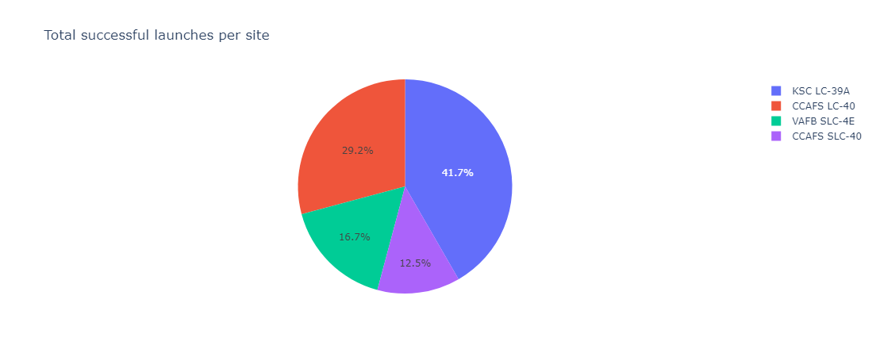
Successful launch distribution per site
Most successful launches were performed in site KSC LC-39A

Slide 41
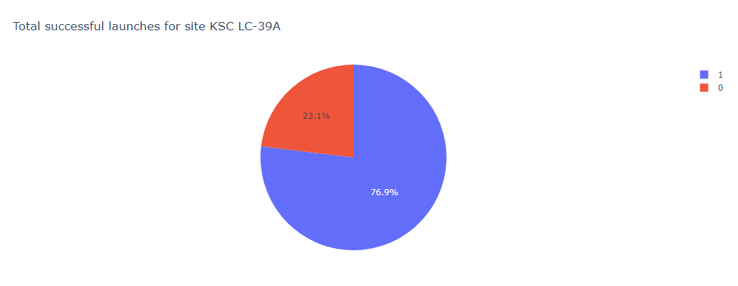
Percentage of successful launches for best performing site
KSC LC-39A is the best performing launch site with a percentage of success of 76.9%

Slide 42
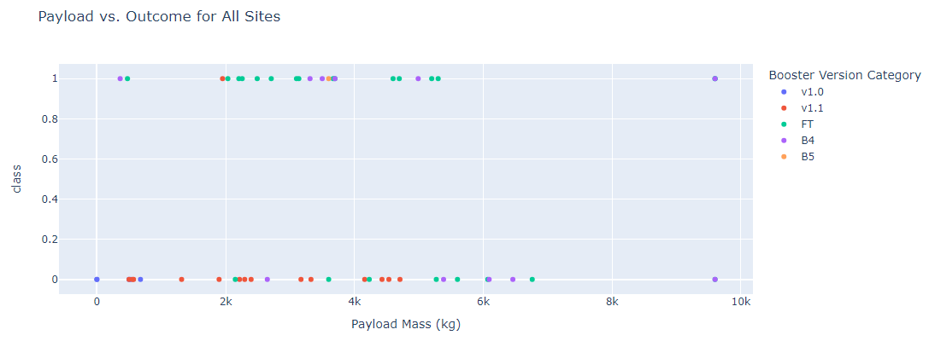
Payload mass vs Success for all sites
This chart does not allow us to see any clear relationship between payload mass and success
Booster v1.1 seems to have a relatively low success rate

Slide 43

Section 5

Slide 44
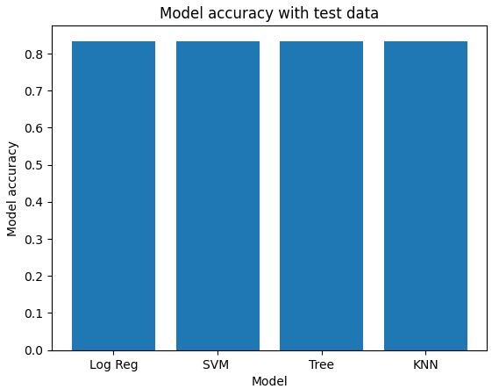
Classification Accuracy
Model accuracy using the testing dataset for the following models:
Logistic regression
Support Vector Machine
Decision Tree Classifier
K Nearest Neighbours
All models have an identical accuracy score

Slide 45
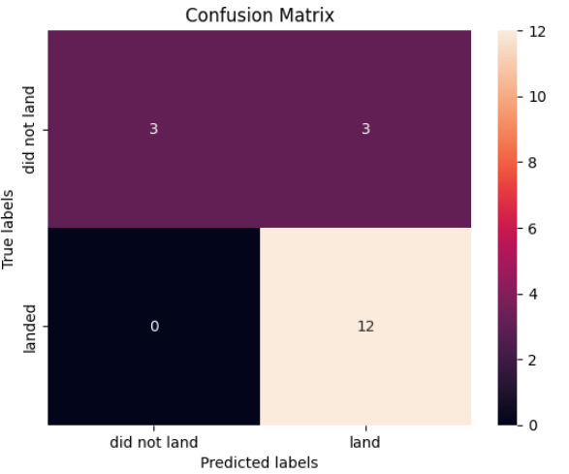
Confusion Matrix
Confusion Matrix for the Decision Tree model
The confusion matrix is identical for all three other models
Overall, the model has a good sensitivity (0 false negatives)
But the specificity could be improved (3 false positives)

Slide 46
Conclusions
The Falcon9 landing success rate clearly improved over time
Falcon9 launch sites are placed on strategic locations:
Close to the southern border of the United States (closer to the equator)
Close to coastlines, railways, highways and at reasonable distance of cities
Four models were fitted for our data:
Logistic regression
Support Vector Machine
All models demonstrated similar accuracy and are therefore equally good for predicting the model
Decision tree
K Nearest Neighbours

Slide 47


Slide 48
Appendix
Link to project GitHub:
https://github.com/tseesen/DataAnalysisProject/blob/main/Week3/spacex_dash_app.py

